Slide 1

Swarm Intelligence
By: Ashok Basnet

Slide 2
Course Outline
Introduction
Background of Ant Intelligence System
Importance of Ant Colony Paradigm
Ant Colony System
Development of Ant Colony System
Application of Ant Colony Intelligence
Working of Ant Colony System
Particle Swarm Intelligence System

Slide 3
Introduction
Ants exhibit remarkable collective intelligence and problem-solving abilities as a group.
Ant Colony Intelligence is a concept inspired by the behavior of ants and their coordination in finding the shortest path between their colony and food sources.
This concept has been applied in various fields to solve optimization problems and improve problem-solving methodologies.

Slide 4
Background of Ant Intelligence System
Ants communicate with each other through chemical signals called pheromones.
Pheromones allow ants to leave trails for others to follow, marking the shortest path to a food source.
Through this indirect form of communication, ants can collectively find the most efficient routes and adapt to changing environments.

Slide 5
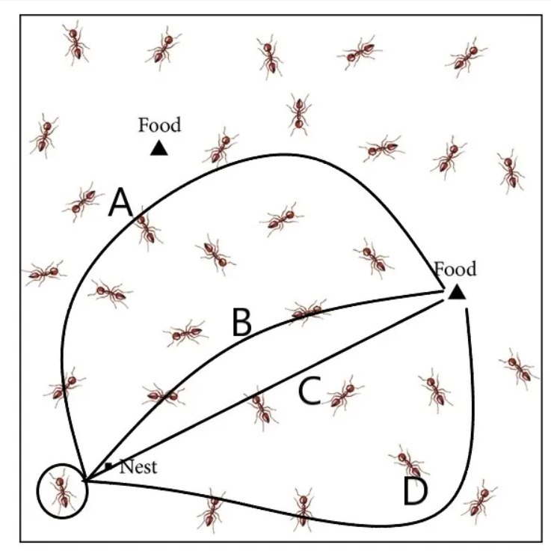

Slide 6
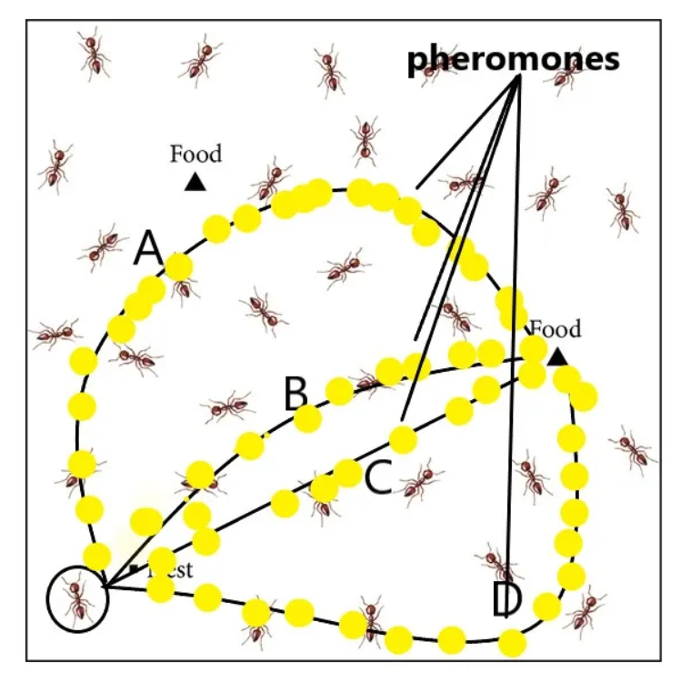

Slide 7
Importance of Ant Colony Paradigm
The Ant Colony Paradigm emphasizes decentralized decision-making and the power of self-organization.
It demonstrates how simple individuals, through local interactions, can collectively achieve complex tasks.
This paradigm has inspired the development of algorithms and systems that harness the power of collective intelligence to solve optimization problems.

Slide 8
Ant Colony System
The Ant Colony System is a metaheuristic algorithm based on the behavior of ants.
It mimics the foraging behavior of ants to solve optimization problems, particularly the traveling salesman problem (TSP) and related routing problems.
The algorithm employs pheromone trails and local heuristic information to guide the search for optimal solutions.

Slide 9
Ant Colony Optimization(ACO) Algorithm
Initialize ACO Parameters
Ant Solution Construction
Position Each ant in the starting node
Each ant will select next node by applying state transition rule
Repeat until ant build the best solution, then compute the fitness value
Update best solution
Apply offline pheromone update
Display the best result

Slide 10
Ant Colony Optimization(ACO) Algorithm
Initialize ACO Parameters
Population Size (k) = 20 (Total number of artificial ants or agents)
MaxT = 200 (Maximum number of iterations)
Tau = 0.5 (Pheromone initial weight)
Alpha = 1 (Pheromone exponential weight)
Beta = 1 (Pheromone heuristic weight)
Rho = 0.05 (Pheromone evaporation rate)

Slide 11
Ant Colony Optimization(ACO) Algorithm
Initialize ACO Parameters
Ant Solution Construction
First start main loop:
CurrentIteration = 1 to Maximum Number of iterations
CurrentIteration = 1 to MaxT
CurrentIteration = 1 to 200

Slide 12
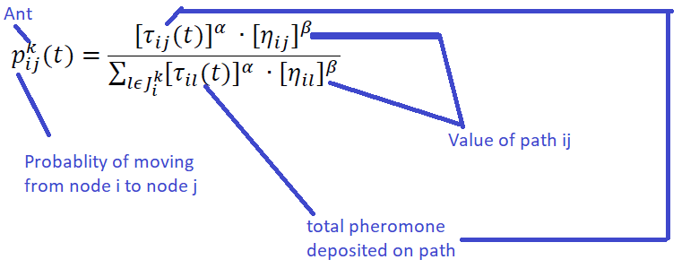
Ant Colony Optimization(ACO) Algorithm
Position Each ant in the starting node
Here, kth ant move from node I to node j with probability [transition probability]

Slide 13
Ant Colony Optimization(ACO) Algorithm
Each ant will select the next node by applying the transition rule.
Repeat until ant builds the best solution
compute fitness value
update the best solution
If ant4(solution) < best solution:
consider ant4(solution)=best solution

Slide 14
Ant Colony Optimization(ACO) Algorithm
Each ant will select the next node by applying the transition rule.
Repeat until ant builds the best solution
compute fitness value
update the best solution
If ant4(solution) < best solution:
consider ant4(solution)=best solution
Increase in levels of pheromone trials =For the Best solution
Decrease in levels of pheromone trails = For Worst solution

Slide 15
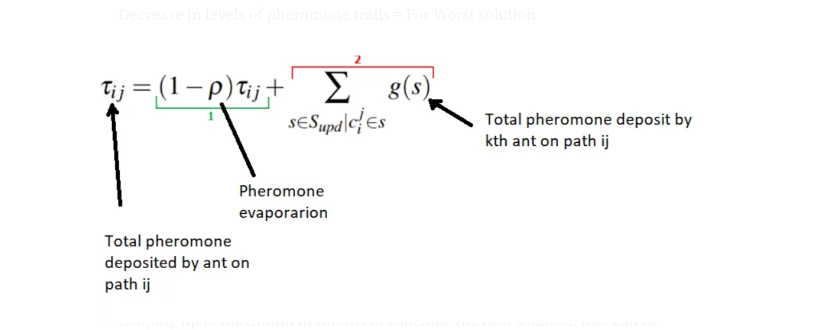
Ant Colony Optimization(ACO) Algorithm

Slide 16
Development of Ant Colony System
The Ant Colony System was first proposed by Marco Dorigo in the early 1990s.
Initially designed to solve the TSP, the algorithm has since been adapted and extended for various optimization problems.
The development of the Ant Colony System has led to improved performance, better solution quality, and wider applicability across different domains.

Slide 17
Application of Ant Colony Intelligence
Routing and logistics optimization: Determining optimal routes for vehicles, minimizing travel costs, and improving delivery efficiency.
Network routing and load balancing: Efficiently routing data packets and balancing network loads to optimize network performance.
Resource allocation and scheduling: Allocating limited resources and scheduling tasks to maximize productivity and minimize costs.
Vehicle routing and transportation optimization: Optimizing routes and schedules for transportation fleets, reducing fuel consumption and improving delivery times.
Manufacturing process optimization: Optimizing production schedules, minimizing downtime, and maximizing throughput in manufacturing environments.
Swarm robotics and unmanned vehicle coordination: Coordinating the actions of multiple robots or unmanned vehicles to achieve complex objectives.

Slide 18
Particle Swarm Intelligence System
Particle Swarm Intelligence (PSO) is another optimization algorithm inspired by the behavior of bird flocking or fish schooling.
PSO involves a population of particles that move through a search space, updating their positions based on their own experience and the influence of neighboring particles.
PSO has been successfully applied in various optimization problems, such as function optimization, neural network.

Slide 19
Explain the basic principle of particle swarm optimization with a suitable example. what are the advantage of particle swarm optimization
The basic principle of Particle Swarm Optimization (PSO) is inspired by the collective behavior of bird flocking or fish schooling. PSO involves a population of particles that move through a search space to find the optimal solution to a given problem.
Each particle represents a potential solution, and its movement is influenced by its own experience and the experience of its neighboring particles.

Slide 20
Imagine you have a group of birds trying to find the location of a food source in an unfamiliar area.
The birds are initially scattered randomly across the space. Each bird's goal is to find the food source, and they communicate with each other to collectively optimize their search.
At each iteration of the algorithm, called a "generation" or "iteration," each bird (particle) adjusts its position based on two factors: its previous movement and the influence of the best position found so far by any bird in the group.

Slide 21
Particle Movement
Each bird keeps track of its own best position (personal best) it has found so far.
Additionally, each bird is also aware of the best position discovered by any bird in the entire group (global best).
Based on these two positions, a bird updates its velocity and moves towards a better position in the search space.
The movement is guided by a combination of its personal experience and the collective experience of the group.

Slide 22
Collective Optimization
As the iterations progress, the birds explore the search space and adjust their positions based on the global best position found so far.
Birds communicate with each other by sharing information about the best position they have found.
This communication enables the birds to exploit promising areas in the search space and avoid getting stuck in local optima.

Slide 23
The algorithm continues iterating until a stopping criterion is met, such as reaching a maximum number of iterations or achieving a desired level of solution quality.
The final position of the particles represents the optimized solution to the problem.

Slide 24
PSO Steps:
Initialize a swarm of particles with random positions and velocities within a defined search space.
Evaluate the fitness (objective value) of each particle.
Update each particle’s personal best if the current fitness is better than its previous best.
Update the global best based on the best fitness value among all particles.
Update the particle velocities and positions using the PSO equations, incorporating personal and global best information.
Repeat steps 2–5 for a specified number of iterations or until a convergence criterion is met.

Slide 25
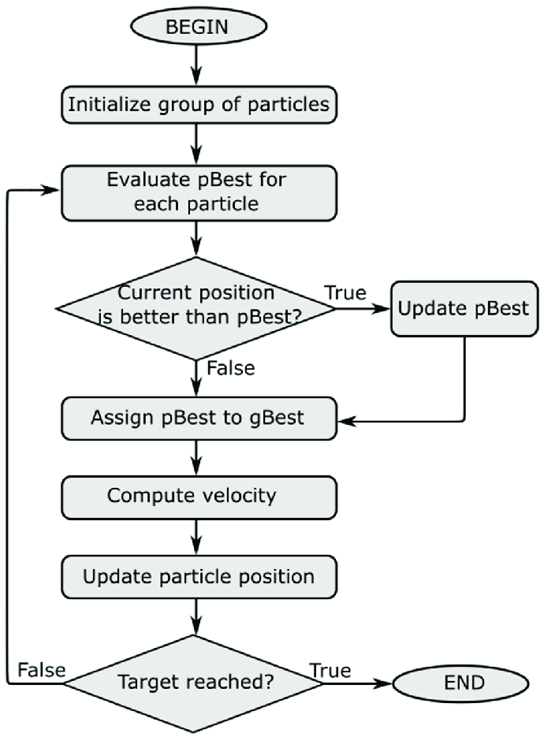

Slide 26
Advantages of Particle Swarm Optimization
Simplicity: PSO is relatively simple to implement and understand compared to other optimization algorithms, making it accessible to a wide range of users.
Global and Local Search: PSO combines global search (influenced by the global best position) and local search (influenced by personal best position) to efficiently explore the search space and converge towards an optimal solution.
Robustness: PSO is robust against noisy or incomplete problem information since it relies on the collective behavior of particles rather than individual fitness evaluations.

Slide 27
Advantages of Particle Swarm Optimization
Fewer Parameters: PSO has fewer parameters to tune compared to other optimization algorithms, making it easier to use and requiring less computational effort.
Applicability: PSO has been successfully applied to a variety of optimization problems, including function optimization, parameter tuning, data clustering, and neural network training.
Overall, Particle Swarm Optimization offers a powerful optimization technique that leverages the collective intelligence of particles to efficiently search and find optimal solutions in various problem domains.

Slide 28
Explain about working of ant colony system with reference to phenomena concept.
The working of the Ant Colony System (ACS) is based on the concept of stigmergy, which is a form of indirect communication observed in social insects like ants.
Stigmergy refers to the process where individuals modify their environment, leaving traces that influence the behavior of other individuals.
The working of the Ant Colony System can be understood through the following steps:

Slide 29
Initialization
Set up the problem and initialize the parameters of the algorithm, such as the number of ants, pheromone levels, and heuristic information.
Define the problem-specific information, such as the distance between cities in the case of the traveling salesman problem (TSP).

Slide 30
Constructing Solutions
Each ant in the colony starts constructing a solution incrementally.
The ant begins by selecting a starting point (city) randomly.
At each step, the ant chooses the next city to visit based on a combination of pheromone trails and heuristic information.
Pheromone trails represent the collective knowledge of the ants and guide the exploration of the search space.
Heuristic information provides additional guidance based on the problem's specific characteristics, such as the distance between cities in the TSP.
The selection of the next city is probabilistic, with higher probabilities assigned to cities with higher pheromone levels and better heuristic values.

Slide 31
Pheromone Update
After all the ants have constructed their solutions, the pheromone levels on the paths are updated.
Ants deposit pheromones on the paths they traverse, with the amount of pheromone proportional to the quality of their solutions.
Pheromone evaporation is applied to prevent excessive accumulation and encourage exploration.
Evaporation reduces the pheromone levels on all paths, gradually fading the influence of outdated information.
The evaporation rate is a parameter that determines how quickly the pheromone levels decay.

Slide 32
Local Search
Optionally, a local search operation can be performed to improve the solutions constructed by the ants.
Local search involves making small modifications to the constructed solutions to explore the nearby neighborhood in the search space.
These modifications aim to enhance the quality of the solutions by swapping or reordering cities while maintaining feasibility.

Slide 33
Termination
The algorithm iterates through the constructing, updating, and local search steps for a specified number of iterations or until a termination criterion is met.
The termination criterion can be a maximum number of iterations, a predefined execution time, or reaching a satisfactory solution quality.

Slide 34
Output
The best solution found by any ant during the execution is considered the output of the Ant Colony System.
This solution represents the optimized solution to the problem at hand, such as the shortest tour in the TSP.
The working of the Ant Colony System is based on the collective behavior of the ants, as they iteratively construct solutions, update pheromone trails, and potentially perform local search operations. The interplay between pheromone trails, heuristic information, and probabilistic decision-making allows the ants to efficiently explore the search space and converge towards promising solutions.

